Slide 1

Local Artisan E-Marketplace
Team ErrorGPT
Md Shafkat Faruk Khan
2022 - 3 - 60 - 035
Uswat Fatemee Maysha Iqra
2023 - 2 - 60 - 077 2023 - 1 - 60 - 152

Slide 2
Motivation
Cultural Preservation
Economic Justice
Digital Inclusion

Slide 3
Types of Stakeholders
Stakeholders
Artisans and Buyers
Regulatory/Support
External/Financial

Slide 4


Slide 5
Functional Requirements
Stakeholder | Essential Action the System Provides | Emphasis
Artisan (Seller) | Bangla-First Listing & One-Click Stock Update. | The artisan needs simplicity: the system must allow listings in Bangla and provide a simple 'Mark Sold Locally' button for stock control.
Buyer (Customer) | Cultural Search & Secure Payment. | The buyer needs trust: the system must allow searching by Cultural Motif (e.g., Nayantara) and guarantee secure payment via mobile banking
Administrator | Transaction Auditing & User Verification. | The admin needs control: the system must generate a full Transaction Audit Log and provide tools to verify new artisan accounts.

Slide 6
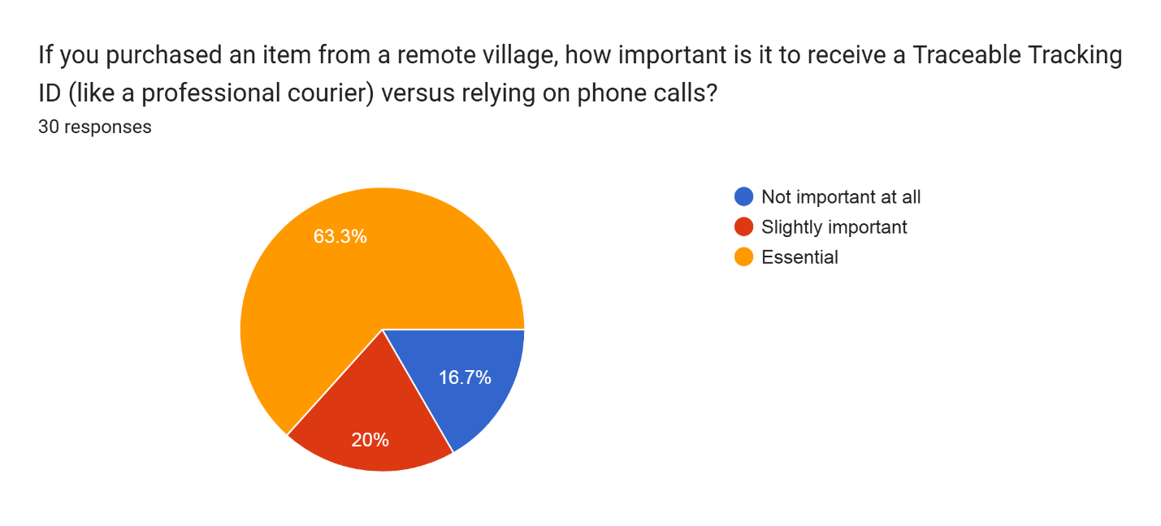
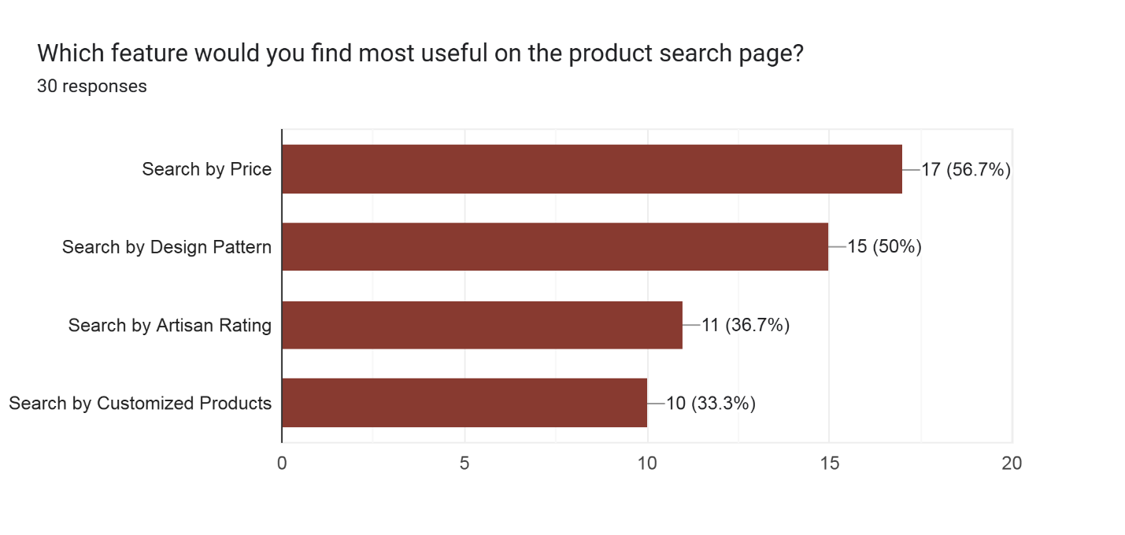
Survey Data

Slide 7
Non-Functional Requirements
Category | Requirement Highlight | Emphasis
Usability (Cultural) | Bangla-First & Icon-Driven Interface. | Our biggest constraint is Usability. The Artisan Dashboard must use minimal text and be designed for accessibility by low-literacy users.
Operational | PostgreSQL Required. | Operationally, we must use PostgreSQL because it ensures the high level of transactional integrity required to prevent system errors.
Reliability | 100% Data Integrity. | The system must achieve 100% data integrity—there can be no failures in the Inventory Locking system that lead to double-selling unique crafts.
Performance | Fast Transactions. | Finally, performance: The critical booking and confirmation process must execute reliably in under 15 seconds.

Slide 8
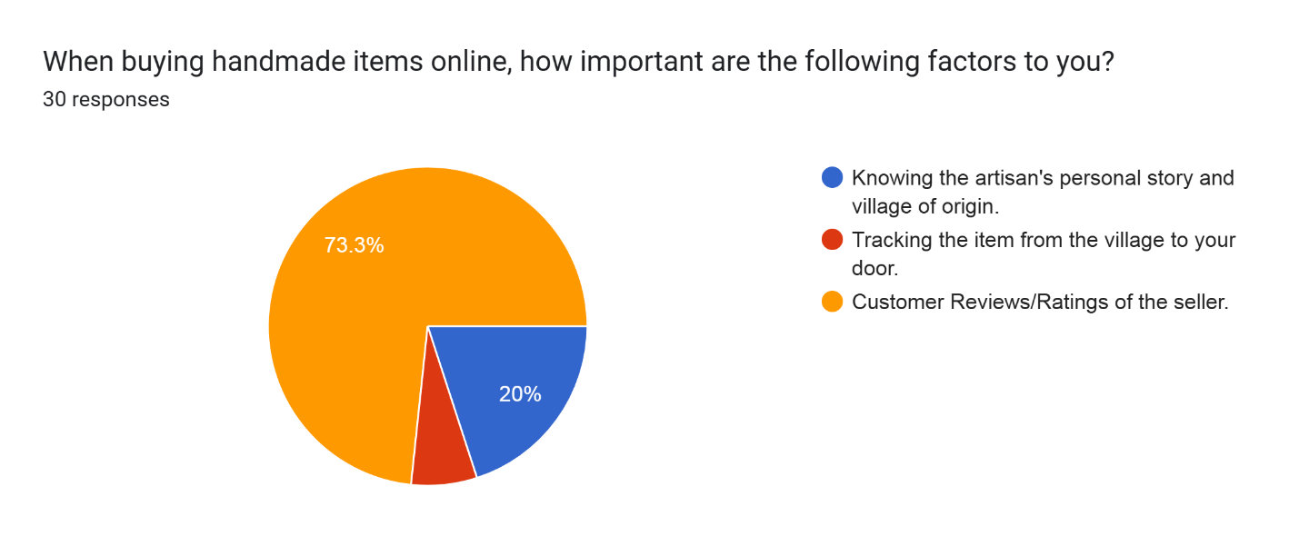
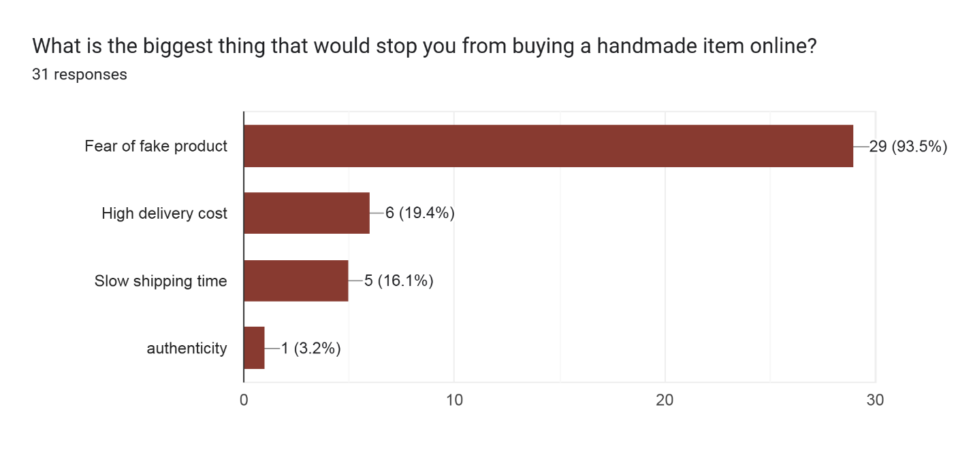
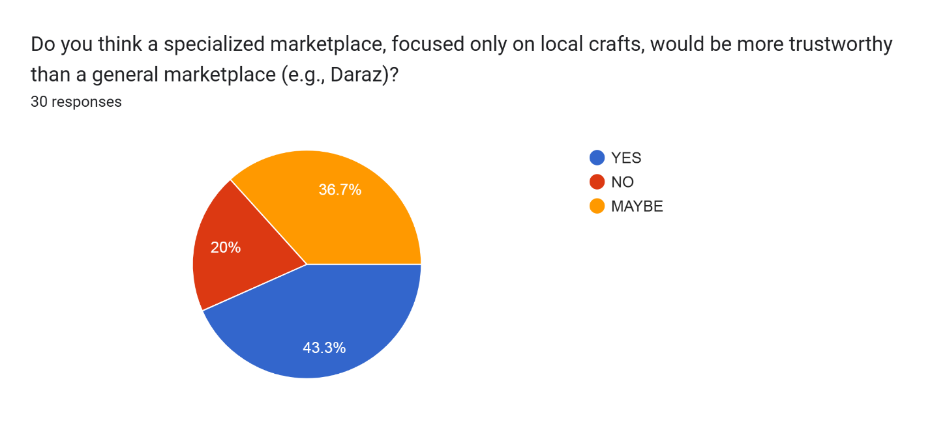
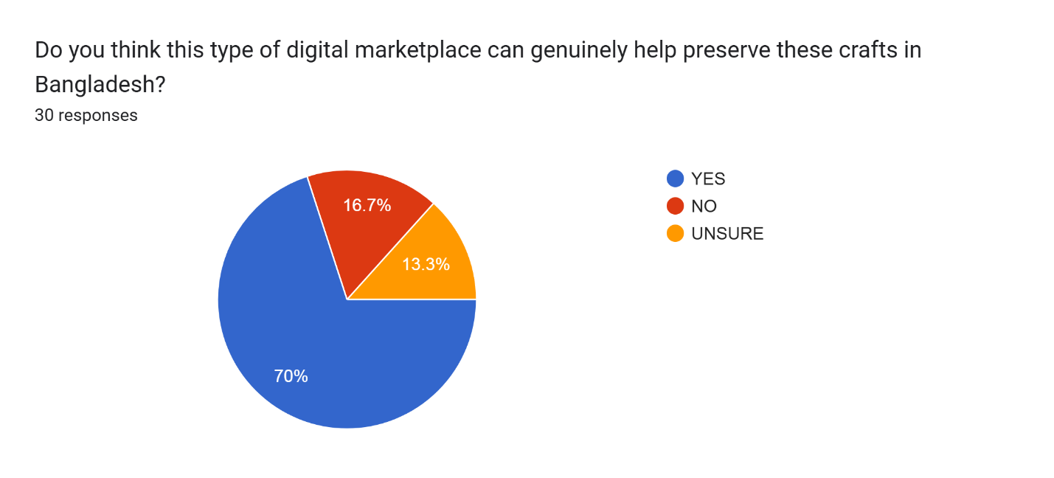
Survey Data

Slide 10


